Slide 1
PREDICTING RENTAL PRICES FOR APARTMENT
Members:
Faryal Zahra
Ayesha Noor
Hira Khalid

Slide 2

1.Problem statement
Why I Choose This Project?

Slide 3
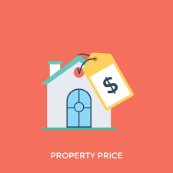
The Challenge
There is no consistent and transparent method for estimating the fair rental price of apartments, leading to inefficiency and confusion for both renters and landlords.
Benefits:
Provides valuable insights for renters and landlords
Assists in making informed decisions
Enables fair price negotiations

Slide 4
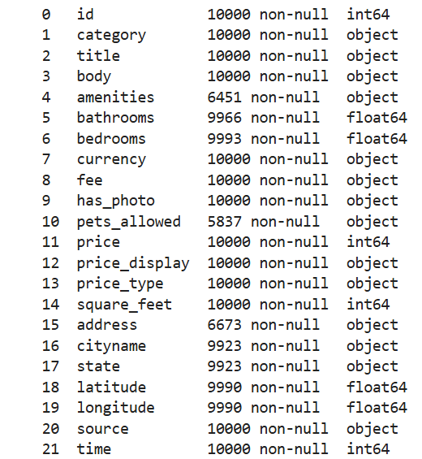
Dataset information
Variables:
Dataset Source:
Chosen from UCI Machine Learning Repository for its relevance and reliability in apartment price prediction.
10K
Rows in Data Set
22
Feature in Data Set

Slide 5
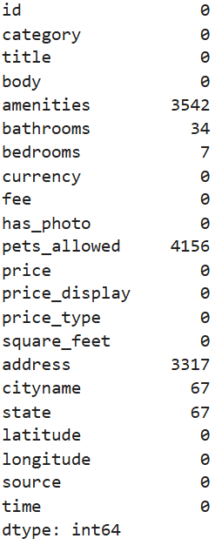
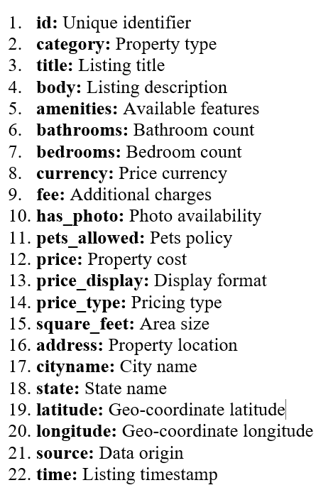
MISSING VALUES:
Detail of Variables:

Slide 6
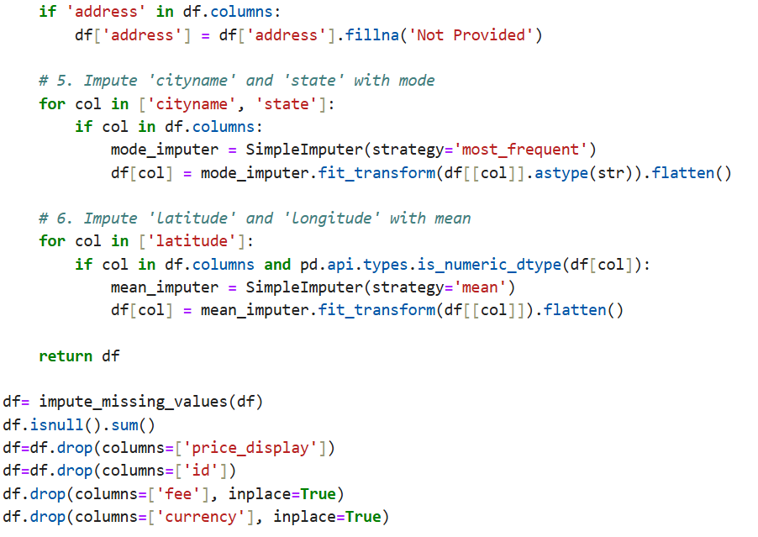
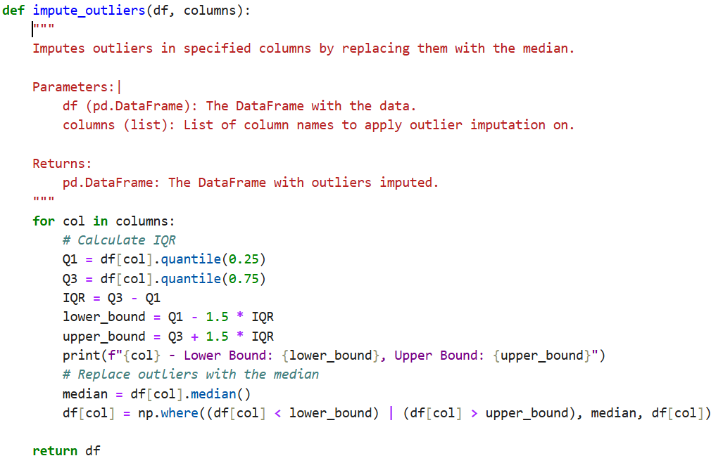
Data Preprocessing
  1.Data Cleaning:
  Impute Missing Values
Impute Outliers

Slide 7
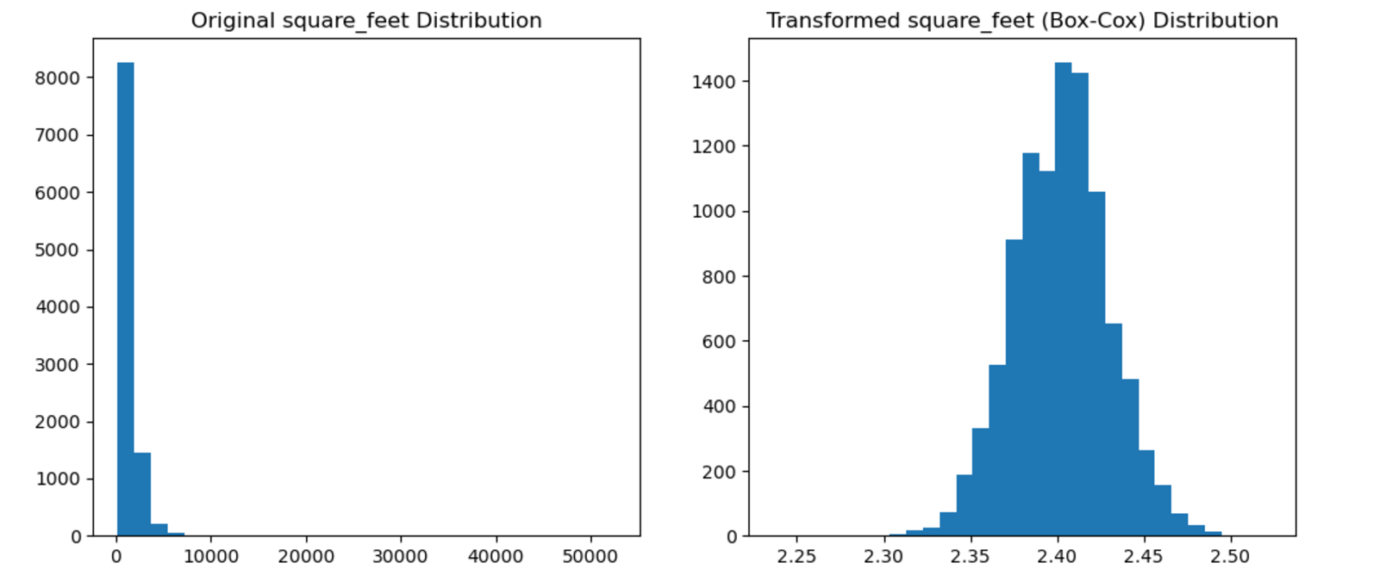
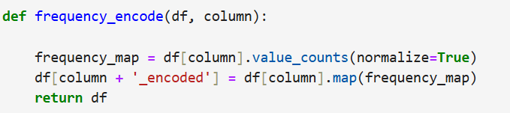
Data Transformation
1.Boxcox Transformation
2.Encoding

Slide 8
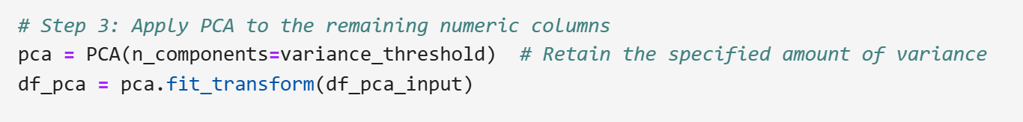
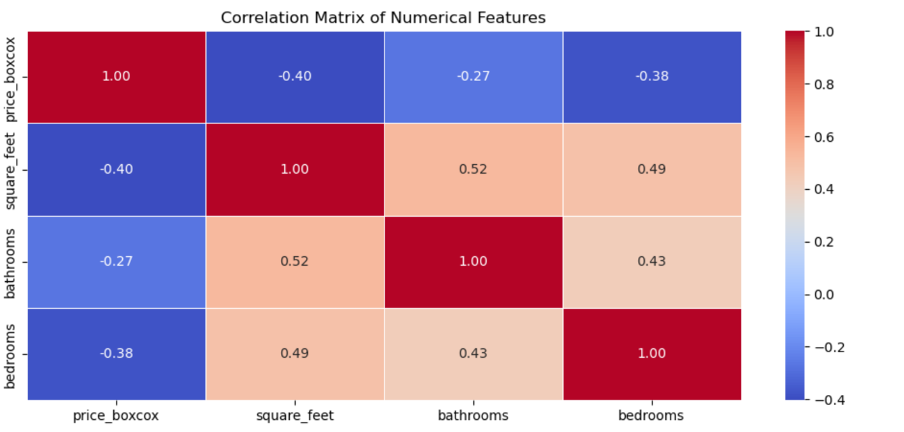
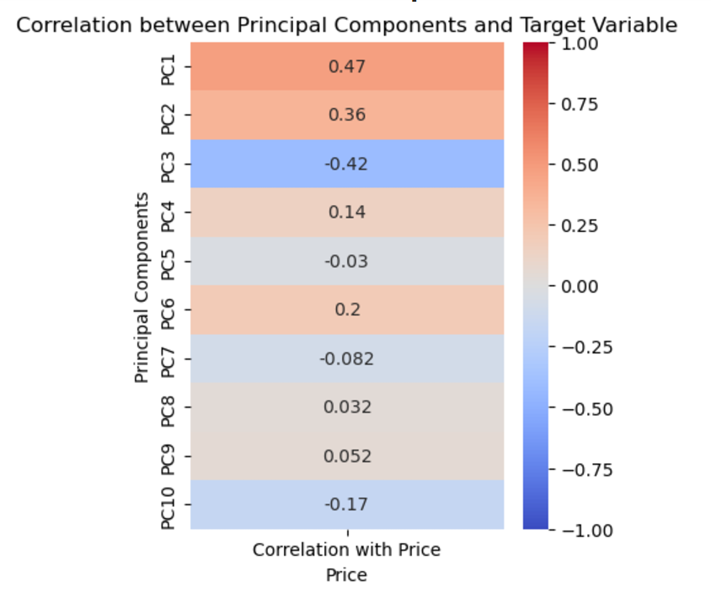
Dimensionality reduction

Slide 9
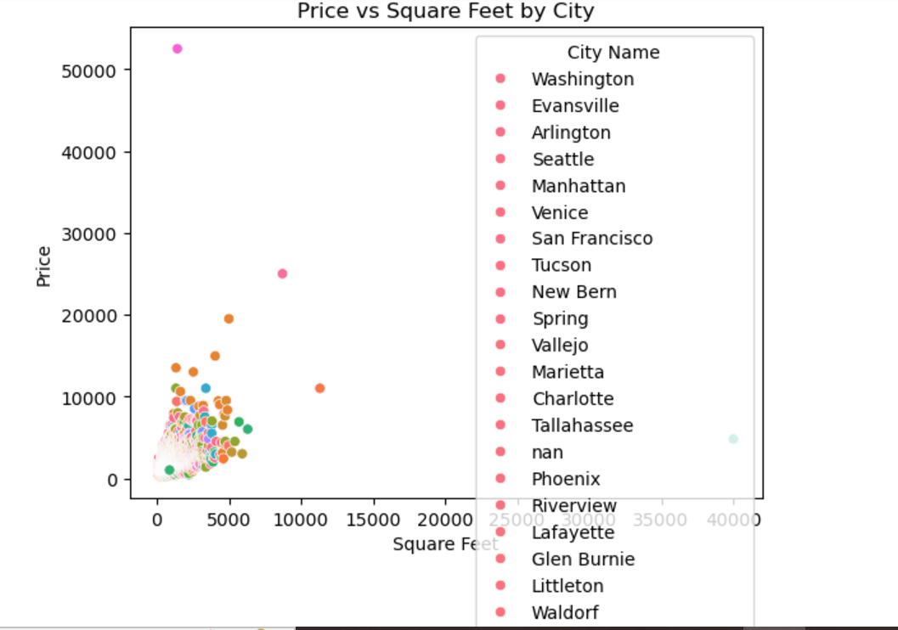
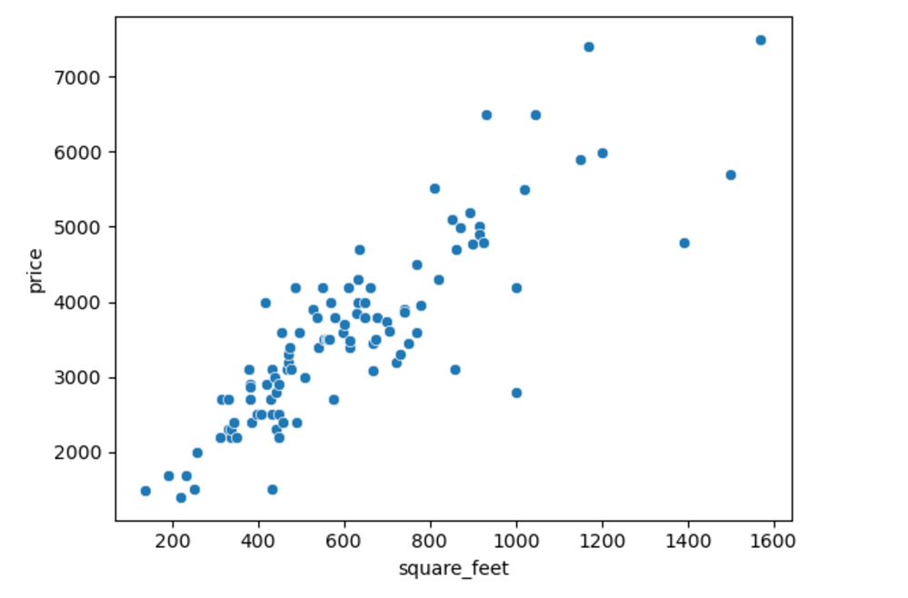
Data Visualization
Scatter Plot

Slide 10
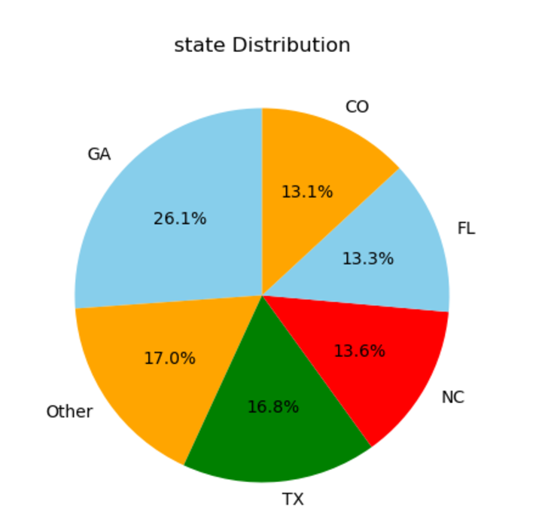
Pie Plot of States
Correlation Heat Map

Slide 11
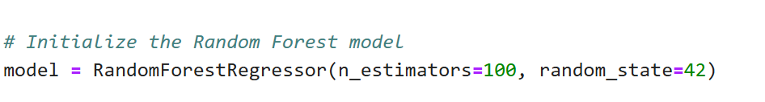
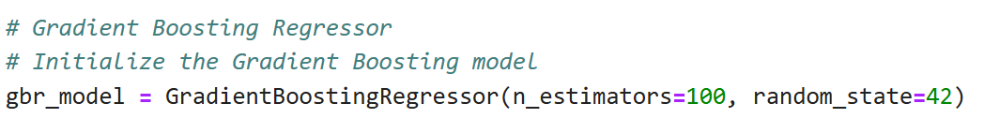
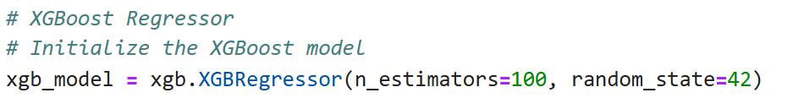
Model Training
Model 1
Model 2
Model 3

Slide 12
Percentages of R^2
Radom Forest Regressor
Gradient Boosting Regressor
XGB
Regressor
0.90
0.89
0.88

Slide 13
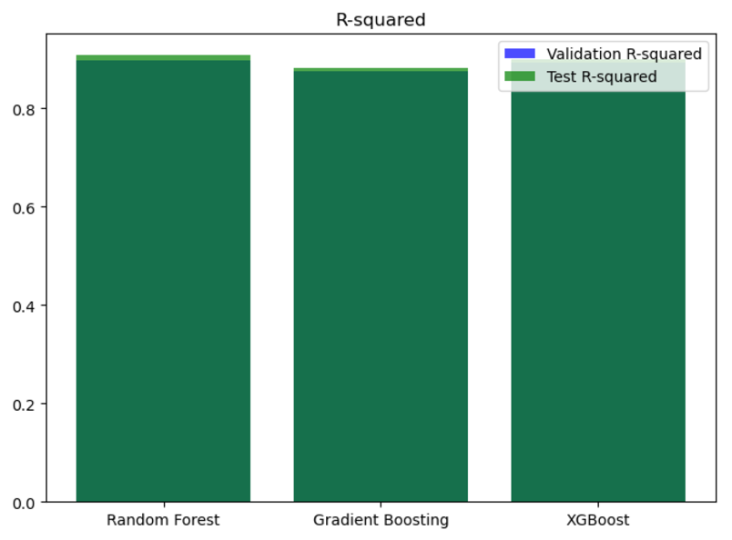
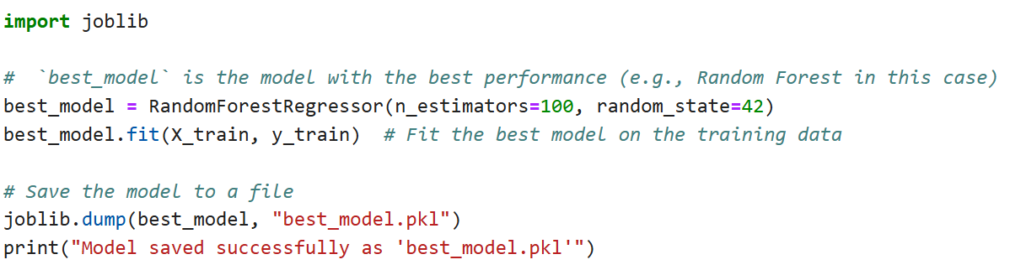
Best model
Random Forest Regressor

Slide 14
Thank You

